Slide 1
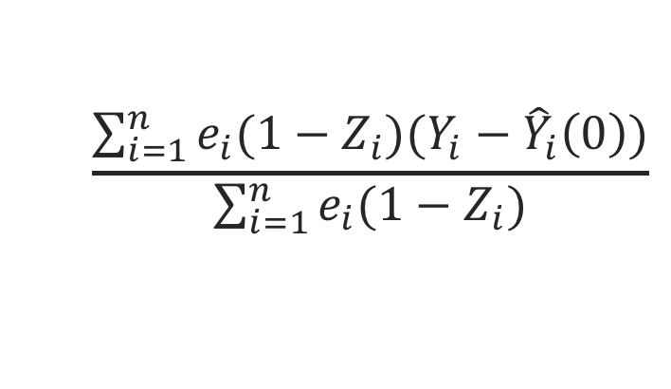
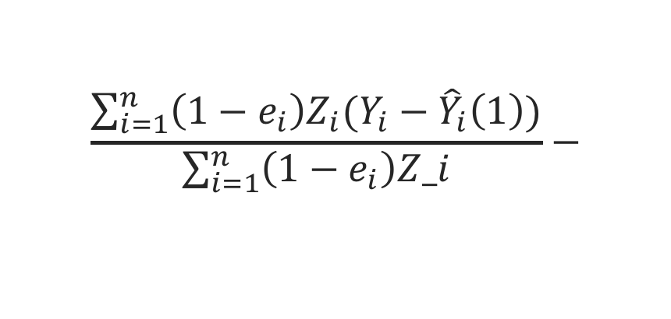
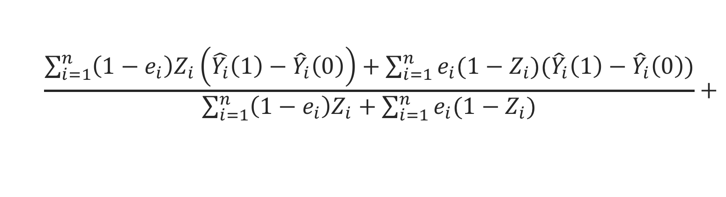
1.
weighting
50%
50%
2.
regression
20%
50%
~ star wars + blue
Hedge your bets
drawing conclusions from non-randomized studies
$$\frac{\sum_{i=1}^{n}{\left(1−e_{i}\right)Z_{i}\left(\hat{Y_{i}}\left(1\right)−{\hat{Y}}_{i}\left(0\right)\right)+\sum_{i=1}^{n}{e_{i}(1−Z_{i})({\hat{Y}}_{i}\left(1\right)−{\hat{Y}}_{i}\left(0\right))}}}{\sum_{i=1}^{n}{\left(1−e_{i}\right)Z_{i}+\sum_{i=1}^{n}{e_{i}(1−Z_{i})}}}+$$
weighting
regression
regression
weighting
$$\frac{\sum_{i=1}^{n}{\left(1−e_{i}\right)Z_{i}(Y_{i}−{\hat{Y}}_{i}\left(1\right))}}{\sum_{i=1}^{n}{\left(1−e_{i}\right)Z_i}}−$$
$$\frac{\sum_{i=1}^{n}{e_{i}(1−Z_{i})(Y_{i}−{\hat{Y}}_{i}\left(0\right))}}{\sum_{i=1}^{n}{e_{i}(1−Z_{i})}}$$

